Slide 1
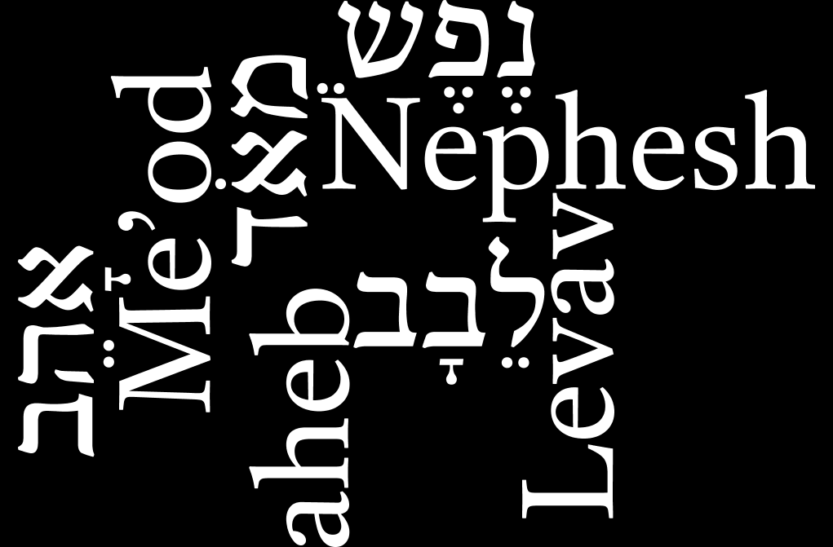
Love matters

Slide 2
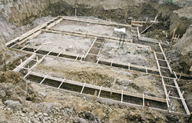
The foundations
It has sometimes been said that the Old Testament is like the foundations of a house and that the New Testament is the structure placed upon it.
As a biased Old Testament guy I have always felt that this analogy was not quite right…
The New Testament functions as the wallpaper, the carpets, the lights, the kitchen, the bathroom, the running water and the central heating.

Slide 3
The foundations
When the Old Testament establishes a floor the Gospels, the Letters, they act as the carpet that covers the floor, which though often unseen supports every step taken on the covering above.
The New Testament is like the lightbulb bringing light to what was obscure.
The Old Testament is the house,
but the New Testament makes it a home.

Slide 4
The Shema (Deuteronomy 6:4-9)
Deuteronomy 6:5 is widely recognised as the most important part of the Torah.
Jesus thought so, citing it when asked to sum up the Torah in the greatest commandment (Mat.22:34-40; Mar.12:30; Luk.10:27).
⁵ You shall love the LORD your God
with all your heart
and with all your soul
and with all your might.
(Deuteronomy 6:5)

Slide 5
The Shema (Deuteronomy 6:4-9)
Shema comes from the Hebrew ‘to hear’, with hearing leading to action.
You are to listen because you value the speaker; you imbibe the message because you value the words; you then demonstrate that value in acting upon the message.
As such, the Shema hearing is not passive, it is the beginning of a process, best understood as hear and do.
It starts off in verse four with:
⁴ Hear, Oh Israel: YHWH our God, YHWH is one.
(Deuteronomy 6:4)

Slide 6
The Shema (Deuteronomy 6:4-9)
The foundation to what it means to be the people of God does not hinge on keeping enough rules to please him, or a completed checklist
The emphasis is appropriate to a relationship based on love.
We are called to love and to put his words in our heart:
⁶ And these words that I command (commission/ entrust) you today shall be on your heart.
(Deuteronomy 6:6)

Slide 7
The Shema (Deuteronomy 6:4-9)
⁷ You shall teach them diligently to your children,
and shall talk of them when you sit in your house,
and when you walk by the way,
and when you lie down,
and when you rise.
⁸ You shall bind them as a sign on your hand,
and they shall be as frontlets between your eyes.
⁹ You shall write them on the doorposts of your house
and on your gates.
(Deuteronomy 6:7-9)

Slide 8
The Shema (Deuteronomy 6:4-9)
The teaching of the children = a multi-generational truth.
Then we have the Hebraic way of positing two extremes such as:
Heights and depths (Psa.139:8; Amo.9:2-4).
⁸ If I ascend to heaven, you are there!
If I make my bed in Sheol, you are there!
(Psalm 139:8)
Or, Morning and evening (Psa.55:17; 119:147-8).
¹⁷ Evening and morning and at noon I utter my complaint and moan,
and he hears my voice.
(Psalm 55:17)

Slide 9
The Shema (Deuteronomy 6:4-9)
By using the two extremes it also includes everything in between.
Deuteronomy 6:7-9 says to remember to love God:
In every generation
In and out of your home (everywhere),
From the end and the beginning of a day (all of the time)
On your hand (all that you do)
Before your eyes (all of your thoughts)
On the entrance of your homes and gates (a constant public reminder).

Slide 10
Deuteronomy 6:5
Remarkable degree of agreement in our translations:
(GNB + NIV) ⁵ Love the Lord your God with all your heart and with all your soul and with all your strength.
(ESV + NKJV) ⁵ You shall love the LORD your God with all your heart and with all your soul and with all your might.
(MSG) ⁵ Love God, your God, with your whole heart: love him with all that’s in you, love him with all you’ve got!
(OJB) ⁵ And thou shalt love Hashem Eloheicha b’chol l’vavcha u’vchol nafshcha uvechol modecha.

Slide 11
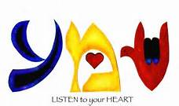
The Shema
שְׁמַע יִשְׂרָאֵל יְהוָה אֱלֹהֵינוּ יְהוָה אֶחָד
וְאָהַבְתָּ אֵת יְהוָה אֱלֹהֶיךָ בְּכָל-לְבָבְךָ וּבְכָל-נַפְשְׁךָ וּבְכָל-מְאֹדֶךָ:
וְהָיוּ הַדְּבָרִים הָאֵלֶּה אֲשֶׁר אָנֹכִי מְצַוְּךָ הַיּוֹם עַל-לְבָבֶךָ

Slide 12
Word 11: אָהֵב (‘ahev/ ‘aheb) Love
There are other terms that could be translated as love.
Terms such as דּוֹד (dode) have a wide variety of uses.
‘aheb which occurs 212 times is supplemented with ‘ahebah (אַהֲבָה) which occurs a further 36 uses of the word.

Slide 13
Word 11: אָהֵב (‘ahev/ ‘aheb) Love
Meaning in use
‘aheb is used to describe the most profound loves of our lives. Such as: The love of parents for children
The love of Abraham for Isaac, his son (Gen.22:2)
The love of Isaac and Rebekah for Esau and Jacob (Gen,25:28)
The love of Jacob for Joseph above his brothers (Gen.37:3, 4; 44:20).

Slide 14
Word 11: אָהֵב (‘ahev/ ‘aheb) Love
The love for a spouse
This is the most common use of the term and it includes:
The love of Isaac for Rebekah (Gen.24:67),
The love of Jacob for Rachel (Gen.29:18, 30 cf. ‘ahebah in Gen.29:20)
The desire of Leah for her husband to love her (Gen.29:32)
The attitude of Shechem for Dinah (Gen.34:3)
In this instance it is a love that cannot be compared to another:
¹⁸ Let your fountain be blessed,
and rejoice in the wife of your youth,
¹⁹ a lovely deer, a graceful doe.
Let her breasts fill you at all times with delight;
be intoxicated always in her love.
(Proverbs 5:18-19)

Slide 15
Word 11: אָהֵב (‘ahev/ ‘aheb) Love
The love between best friends
David and Jonathan (1Sa.18:1, 3, 16; 20:17; 2Sa.1:23, 26).
The devotion or affection for someone
A devoted servant to his master (Exo.21:5);
Saul’s affection for David (1Sa.16:21; 18:22); and King Hiram for David (1Ki.5:1; 2Ch.2:11)
Loving the neighbour
The extent that God wished to see the people love the neighbour (Lev.19:18, 34; Zec.8:17).
Favourite food
It is also used by Isaac when he is exaggerating to Esau how much he adores his food, (Gen.27:4, 9, 14).

Slide 16
Word 11: אָהֵב (‘ahev/ ‘aheb) Love
Given that the term was to express the strongest expressions and bonds of love it was also used with a spiritual dimension:
The love of God for the people
Alongside Hesed we have a more relatable example in ‘aheb. (Deu.4:37; 7:13; 10:15, 18; 15:16; 23:5; 2Sa.12:24; 1Ki.10:9; 2Ch.20:7; Psa.47:4; 78:68; 146:8; Pro.3:12; Dan.9:4; Hos.11:1; Mal.1:2 cf. ‘ahebah in Deu.7:8; 2Ch.9:8; Jer.31:3):
⁹ In all their affliction he was afflicted, and the angel of his presence saved them; in his ‘aheb and in his pity he redeemed them; he lifted them up and carried them all the days of old.
(Isaiah 63:9)

Slide 17
Word 11: אָהֵב (‘ahev/ ‘aheb) Love
God loving righteousness/ justice
There are things that God loves passionately (Psa.33:5; 37:28; 45:7; Amo.5:15; Mic.3:2)
The love of people for God
This love is to be reciprocated (Exo.20:6; Deu.5:10; 6:5; 7:9; 10:12, 19; 11:1, 13, 22; 13:3; 19:9; 30:16, 20; Jos.22:5; 23:11; Jdg.5:31; 1Ki.3:3; Neh.1:5; Psa.5:11; 31:23; 97:10; 116:1; 119:132; 122:6).
Love of the Torah
This degree of passion is therefore seen in the love of the Torah which reveals God (Psa.119:48, 97, 113, 119, 127, 140, 159, 163, 165, 167).

Slide 18
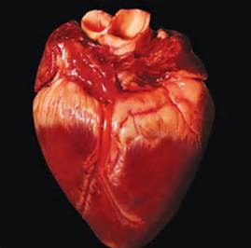
Word 12: לֵבָב (Levav) heart
TASK: How do you understand heart?
What does it mean when you are told to love God with your heart?

Slide 19
Word 12: לֵבָב (Levav) heart
לְבַב (occurring 251 times) and לֵב (occurring 698 times) are both usually rendered as heart.
Now, when we think of the heart we usually imagine the seat of the emotions
The Hebrews (and Greeks) placed this in their bowels (Psa.40:8).
We usually associate emotions with the heart, both positive ones such as love, and negative ones where our hearts can store up hate.

Slide 20
Word 12: לֵבָב (Levav) heart
This is also the case when we come to Levav as we see in the love of the Song of Songs:
(ESV) ⁹ You have captivated my heart, my achoth, my bride; you have captivated my heart with one glance of your eyes, with one jewel of your necklace.
(Song of Songs 4:9)

Slide 21
Word 12: לֵבָב (Levav) heart
Other examples include:
Love (Deu.10:16; 11:13; 13:3 cf. Lev in Jdg.16:15, 17; Son.4:9)
Hate (Lev.19:17; Zec.8:17)
Fear (Lev.26:36; Deu.1:28; 20:3 cf. Jos.2:11; 5:1; 7:5; etc).
Pride (Lev.26:41; Deu.8:14; Isa.9:9)
Grief (1Sa.1:8 cf. Lev in Gen.6:6)
Lust (Pro.6:25)
In each of these examples we see the emotions being readily associated with the heart. It is therefore simple to see why levav was translated as heart, where we imagine to store our emotions.

Slide 22
Word 12: לֵבָב (Levav) heart
However, ‘heart’ does not actually fit the majority of the times levav is used. This is reflected in some of the modern translations when it comes to Pharaoh in Exodus 14:5:
⁵ When the king of Egypt was told that the people had fled, the mind of Pharaoh and his servants was changed toward the people, and they said, "What is this we have done, that we have let Israel go from serving us?"
(Exodus 14:5)
Ezekiel 38:10 provides a parallel between levav and thoughts:
"Thus says the Adonai YHWH: On that day, thoughts will come into your mind, and you will devise an evil scheme.
(Ezekiel 38:10)

Slide 23
Word 12: לֵבָב (Levav) heart
Indeed, it is more common to have the term refer to:
Thinking (Deu.15:9; 1Ch.29:18; Job.17:11; Psa.139:23; Eze.3:10; 38:10) (cf. Lev in Gen 6:5; 24:45; Num.16:28; Jdg.5:15; Psa.33:11; Jer.23:20)
An inner monologue (Deu.7:17; 8:17; 9:4; 18:21; Isa.14:13; 49:21; Jer.5:24; 13:22; Zep.1:12; 2:15 cf. Lev in Gen.8:21; 17:17; 27:41; 1Sa.27:1; Psa.10:6; Ecc.2:1, 15) + the fool of (Psa.14:1; 53:1)
Considered opinions (Deu.4:39; 8:5 cf. Lev in Jdg.9:3)
Imagination (Zec.7:10; 1Ch.29:18) and planning (1Ch.22:7; Pro.16:9)
Studying (Ezr.7:10) and learning (Deu.11:18)
A place of wisdom (Job.9:4; Psa.90:12; Isa.10:7)
A place of knowledge (Deu.4:9; 8:2)

Slide 24
Word 12: לֵבָב (Levav) heart
The problem of sticking with heart when mind is clearly an option is seen in well-known texts such as Isaiah 6:10:
¹⁰ Make the heart of this people dull,
and their ears heavy,
and blind their eyes;
lest they see with their eyes,
and hear with their ears,
and understand with their hearts,
and turn and be healed."
(Isaiah 6:10)

Slide 25
Word 12: לֵבָב (Levav) heart
The levav can clearly be equated with the mind as well as the heart. Where thoughts, plans, wisdom and studying take place as well as the emotions. It is also where memory and learning are stored:
⁴ he taught me and said to me, "Let your heart hold fast my words; keep my commandments, and live.
(Proverbs 4:4)
"And when all these things come upon you, the blessing and the curse, which I have set before you, and you call them to mind among all the nations where the LORD your God has driven you,
(Deuteronomy 30:1)

Slide 26
Word 12: לֵבָב (Levav) heart
The levav is also where your will, awareness and intentions reside. This can be seen in:
The hardening of the heart (Num.15:39; Deu.15:7; cf. Lev in Exo.7:13, 14, 22; 8:15, 19; 10:1).
In being unaware of something (Gen.31:26)
The example of Abimelch:
⁵ Did he not himself say to me, 'She is my sister'? And she herself said, 'He is my brother.' In the integrity of my heart and the innocence of my hands I have done this."
(Genesis 20:5)
Abimelech declares himself to be innocent and to have acted with a levav of integrity. We could say that his intentions had been honourable, and it is this notion of being upright that we find in 1 Kings 9:4 and Psalm 78:72 (cf. Deu.9:5):
⁴ And as for you, if you will walk before me, as David your father walked, with integrity of heart and uprightness, doing according to all that I have commanded you, and keeping my statutes and my rules,
(1Kings 9:4)
⁷² With upright heart he shepherded them and guided them with his skilful hand.
(Psalm 78:72)

Slide 27
Word 12: לֵבָב (Levav) heart
Simply replacing heart with brain will not do, as this removes emotions and personality traits such as stubbornness (Deu.4:9).
The levav also governs our actions (1Sa.14:7; 2Sa.7:3; 1Ch.17:2; Job.1:8 cf. Lev in 1Ch.28:9; Jer.4:14) which is of course what Christ says (Mar.7:21).
Levav is associated with love, hate, lust, panic, fear, courage, intentions, study, grief, thinking, wisdom, knowledge, understanding and learning.
As such, emotion, intention and rational thought are included in the levav. Yet the word heart would most naturally exclude much of this.

Slide 28
Heart?
Fear
Hate
Love
Thinking
Levav
Intent
Wisdom
?

Slide 29
Word 13: נֶפֶשׁ (Nephesh) ‘Soul’
TASK: How do you understand soul?
What does it mean when you are told to love God with your soul ?

Slide 30
Word 13: נֶפֶשׁ (Nephesh) ‘Soul’
Occurring 753 times this is a fairly significant term in understanding the afterlife and the nature of what God saves.
Pagan mythology of the soul
The duality of man, of an eternal divine spark and the flesh as separate elements of man which separate at death is an idea borrowed from pagan Greek philosophy and mythology.
The pagans believed that the soul would be separated out at death and live as a shade in the underworld (as in the poems of Homer).
This idea was Christianized by the early church and can be seen in the works of early church fathers such as Origen, Augustin and St Gregory of Nyssa.
Indeed, based on the ‘Institutes’, Calvin adopted the idea that sin is essentially in the flesh of the believer and is left behind at death. This dualism also essential in Catholic theology can also therefore be seen in documents such as the Westminster Confession of Faith.

Slide 31
Word 13: נֶפֶשׁ (Nephesh) ‘Soul’
The Westminster Confession of Faith claims that:
32.i. The bodies of men, after death, return to dust, and see corruption: but their souls, which neither die nor sleep, having an immortal subsistence, immediately return to God who gave them.
(It will at a later point talk about bodies being provided after Judgement.)
Part of the problem is that the use of the term soul in the New Testament is assumed to correlate with the thought of Socrates, Plato or Xenophon rather than Moses, Job or Daniel and so what is said on the soul becomes pagan rather than biblical.

Slide 32
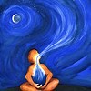
Word 13: נֶפֶשׁ (Nephesh) ‘Soul’
Meaning in use
Nephesh does not mean soul
Nephesh = breath and life
Genesis 1:30 = the breath of life in every living creature (2:19).
Adam has Nephesh breathed into him and at that point becomes a living nephesh.
Adam has life breathed into him and at that point becomes a living nephesh. The text clearly states that he is a nephesh not that he has a nephesh:
⁷ then YHWH ‘Elohim formed the man of dust from the ground and breathed into his nostrils the breath of life, and the man became a living nephesh.
(Genesis 2:7)
Similarly the boy revived by Elijah in 1 Kings 17 the nephesh of the boy came back into him.

Slide 33
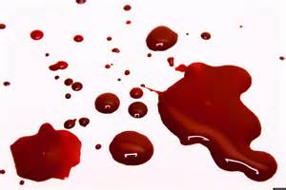
‘Soul’ Nephesh (נֶּפֶשׁ)
Nephesh = flesh and blood
Genesis 9:4 connects nephesh with flesh and blood.
Genesis 14 talks of the physical person as Nephesh
Genesis 46:18 talks of your children as your nepheshes.
Leviticus 24:17 the nephesh can be put to death.
Numbers 6:6 (9:2 etc) talks of a corpse as the nephesh of the dead.
Psalms tend to place nephesh in parallel with flesh, (such as Psalm 63:1).

Slide 34
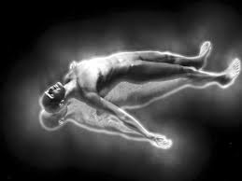
Soul?
Body
Flesh
Blood
Corpse
Nephesh
Life
Breath
?

Slide 35
The afterlife
The Hebrew text provides quite a lot of information on the Resurrection (such as 1Sa.2:6; Psa.73:23-26; Isa.25:8; Isa.26:19-21; Hos.13:14).
Throughout it is clear that a body / soul separation is an alien idea, especially when the texts we read as soul actually refer to the physical aspect of man.
There are a number of texts that would support the idea of a time of sleeping until the whole of man is raised (Job 14:10-14):
² And many of those who sleep in the dust of the earth shall awake, some to everlasting life, and some to shame and everlasting contempt.
(Daniel 12:2)
¹⁹ Your dead shall live; their bodies shall rise. You who dwell in the dust, awake and sing for joy! For your dew is a dew of light, and the earth will give birth to the dead.
(Isaiah 26:19)

Slide 36
The afterlife
Indeed, we can on occasion specifically read that the nephesh is to be raised up so that the whole of man can be with God (Job 19:25-27; Psa.16:9-11; 17:15):
¹⁵ But God will ransom my nephesh from the power of Sheol,
for he will receive me.
Selah.
(Psalm 49:15)

Slide 37
Heart and Soul?
Levav (emotions, thoughts, intent)
+
Nephesh (breath, blood, flesh)
=
The physical + the non-physical
Hardware and software?

Slide 38
Word 14: מְאֹד (Me’od) ‘might’
TASK: How do you understand strength or might?
What does it mean when you are told to love God with your strength or might?

Slide 39
Word 14: מְאֹד (Me’od ) completely / to the ^{nth} degree + might + potential
Occurring 300 times it is again a rather common term.
The most frequent use is as an adverb to give a sense of extreme:
The vehemence of Cain’s attitude to Abel (Gen.4:5)
The waters that utterly covered the earth (Gen.7:19)
The spectacular wealth of Abram (Gen.13:2)
The unsurpassed Wisdom of Solomon (1Ki.4:29)
The excessive sin of Sodom (13:13).
It is a term that in our idiom is an action to the n^{th} degree (or givin’. It laldie).
It is not really ever translated as strength or might except in this instance
It is a term of absolute:
³¹ And God saw everything that he had made, and behold, it was Me’od tov. And there was evening and there was morning, the sixth day.
(Genesis 1:31)

Slide 40
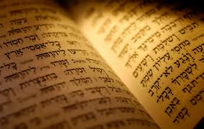
Translating Deuteronomy 6:5
Bearing all that in mind,
how should we translate Deuteronomy 6:5?

Slide 41
I would probably do something like this:
⁵ Now really love (‘aheb) YHWH your God (of gods)
with everything that makes you human (levav),
and with every living breath (nephesh),
and do it utterly and completely.
(Deuteronomy 6:5)

